Slide 1
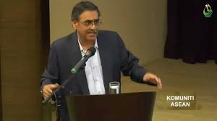
Invitation
Prof. Dr. Jatswan Singh
University of Malaya, Kuala Lumpur, and Visiting Professor at the WSF
“Malaysia‘s Foreign Policy”
Public lecture as part of the seminar
“International Relations of the Asia Pacific Region”
Tuesday, 02.06., 11.15-12.45, R124,
Ulmenstraße 69, Haus I
This lecture will discuss the evolution of Malaysian foreign from independence in 1957 till the present. Despite being a relatively small state, Malaysia has played a significant role in international relations, especially since the 1980s. From a country that was once in the backwaters of mainstream international relations, Malaysia has emerged as a major player in the international relations of the Asia-Pacific through its role as a medium power
ALL WELCOME
INSTITUT FÜR POLITIK- UND VERWALTUNGSWISSENSCHAFTEN
LEHRSTUHL INTERNATIONALE POLITIK UND ENTWICKLUNGSZUSAMMENARBEIT
Prof. Dr. Jörn Dosch

